Slide 1
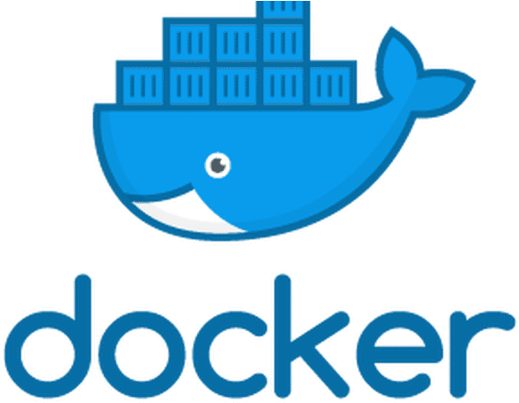
Docker 101
Most of the examples here are available at https://github.com/bassmandja/docker101

Slide 2
What is Docker?
Docker is a containerization technology that enables lightweight application segmentation, portability and isolation
Functionally similar to, but much lighter weight than, traditional Virtual Machines (VMs)
Four to six times more containerized applications can be run on a given server machine than the if the applications were to be run in separate VMs (when done properly)
Docker lends itself to Continuous Integration/Continuous Deployment (CI/CD) build, test and deployment environments
Used heavily in cloud-scale application development

Slide 3
How does Docker differ from traditional VMs?
VMs use hardware virtualization and hypervisors, and can run different operating systems and kernels on separate VMs on the same hardware
Docker uses OS virtualization, the host kernel is shared among all containers
VMs running on the same host may be more secure than containers, but when developing or running trusted containers, this is often not a primary concern
Containers boot much faster than VMs (milliseconds vs. seconds), which makes scaling applications up and down much simpler

Slide 4
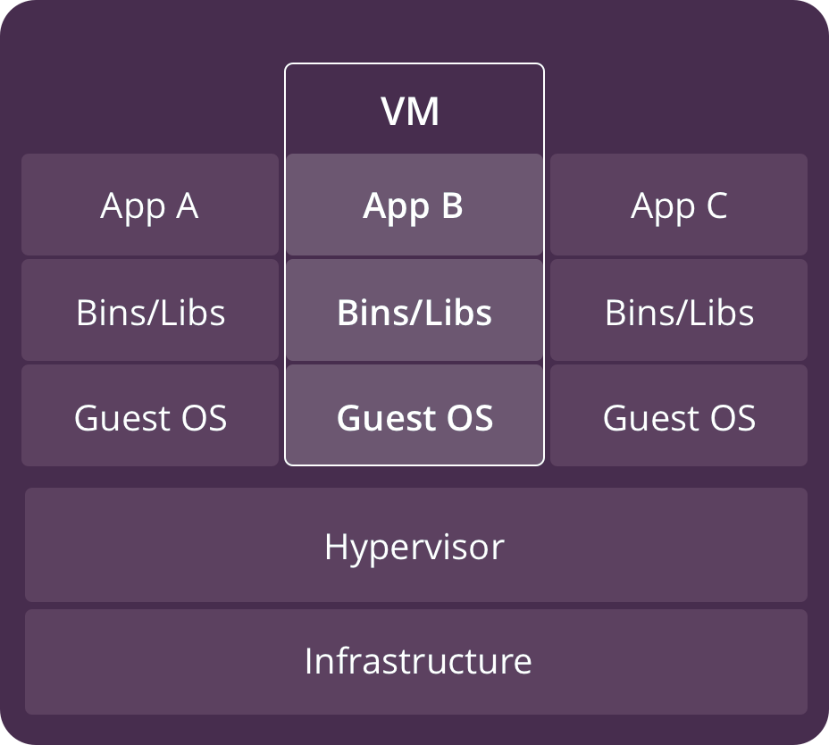
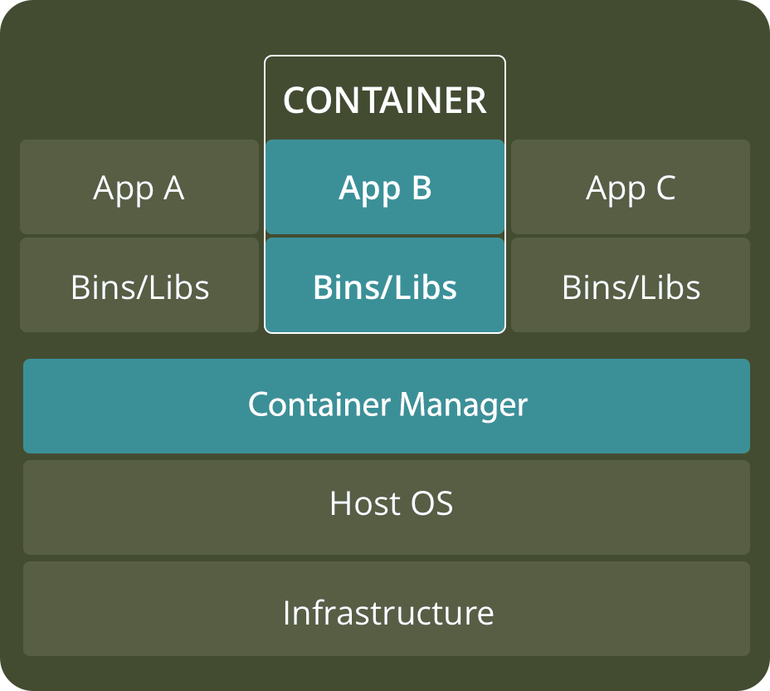
VMs vs. Containers

Slide 5
Benefits of Containers
Reduced IT management resources
Reduced size of snapshots vs. VM images
Quicker spinning up apps – milliseconds to a few seconds vs. many seconds to minutes
Reduced & simplified security updates
Less code to transfer, migrate, upload workloads
Isolated application environment
Complex environments are easily shared, when built properly e.g. without external dependencies. Solves the ‘works on my machine’ problem
Greatly improved repeatability for application build and deploy

Slide 6
What Docker can help with at SSCI
Containerizing complex build environments can eliminate the dependency on a single, hard to maintain build machine
Containers can make it easy to have multiple, different test environments that can be layered on top of a common substrate
Docker container layers can help abstract common environments, allowing developers to focus on any additional configuration or tooling needed to, for example, build multiple versions of a system as requirements change over time.

Slide 7
Getting started with Docker
https://phoenixnap.com/kb/how-to-install-docker-on-ubuntu-18-04
docker run hello-world
docker pull python
docker image ls
docker ps [-a]
docker history python:latest
docker system prune -a

Slide 8
Example Python application (Python 3.6+)
import platform
print(f'Hi from Python {platform.python_version()}')

Slide 9
Example Dockerfile
FROM python:latest
COPY hi.py .
CMD python hi.py

Slide 10
Building and running a Docker image
docker build . --tag hi:latest
docker run hi

Slide 11
Peeking inside the container
Most interactions with containers are from outside – i.e. from the context of the host OS. But you can, in many circumstances, run a shell inside the container and issue commands to the containerized OS
docker run -it hi /bin/sh
ls
whoami
python --version

Slide 12
Persisting files across container invocations
Any files written to the container’s internal filesystem at runtime are saved in a tmpfs and do not persist across container invocations
If you need persistent data for your containerized applications, you will need to mount a volume inside your container
A mounted volume can be any directory on the host. Files written or read by the container can be stored there and will persist across container invocations
Containers run (internally) as root, by default. You can change the user and group IDs that run inside the container.

Slide 13
Mounted volume examples
cd mount
docker build . --tag writer:latest
docker run writer foo.txt
docker run --rm -it --entrypoint=/bin/sh writer
docker run -v $(pwd)/:/host writer:latest /host/bar.txt
docker run --user $(id -u):$(id -g) -v $(pwd)/:/host writer:latest /host/baz.txt

Slide 14
Container orchestration with docker-compose
version: '3'
services:
server:
build: server/
ports:
- "1234:1234"
client:
build: client/
command: "hello from docker-compose"
network_mode: host
depends_on:
- server

Slide 15
Use cases
For the Blackjack project, Dan Heinen and Jenny Ribeiro put together a Dockerized demo with four containers that communicate data between each other over a ROS backbone
I took their demo and made a docker-compose file that runs it in a single window

Slide 16
Reference and Further Reading
https://docs.docker.com/samples/
https://docs.docker.com/develop/develop-images/dockerfile_best-practices/
https://cloud.google.com/blog/products/gcp/7-best-practices-for-building-containers

Slide 17
Useful docker commands
Save a container to a .tar or .tar.gz:
docker save myimage:latest > myimage_latest.tar
docker save myimage:latest | gzip > myimage_latest.tar.gz
Load a container from a .tar or .tar.gz:
docker load < myimage_latest.tar
docker load < myimage_latest.tar.gz

